Slide 1
A Multi-Decade Longitudinal Analysis of Transportation and Land Use Co-Evolution in the Greater Toronto-Hamilton Area
Dena Kasraian
Shivani Raghav
Bilal Yusuf
Eric Miller

Slide 2
Documenting transport infrastructure (transit and road) development and urbanization in the GTHA over half a century (1966 to 2016)
Calculation of accessibility change (transit vs road)
Longitudinal analysis of accessibility in relation to various factors (population growth, land development, emergence of activities, etc.)
Research aim

Slide 3
Data sources
Built-up Area
Canada Land Use Monitoring Program (CLUMP) urban land use 1966-1986
Creator: Natural Resources Canada
1966, 1971, 1976, and 1981, 1986
AAFC Land Use
Creator: Agriculture and Agri-Food Canada
1990, 2000 and 2010
Transportation infrastructure
EMME Transportation networks
Creator: Travel Modelling Group, University of Toronto Transportation Research Institute, UofT
1971, 1976, and 1981 (derived from 1986 networks)
1986, 1991, 1996, 2001 and 2011

Slide 4
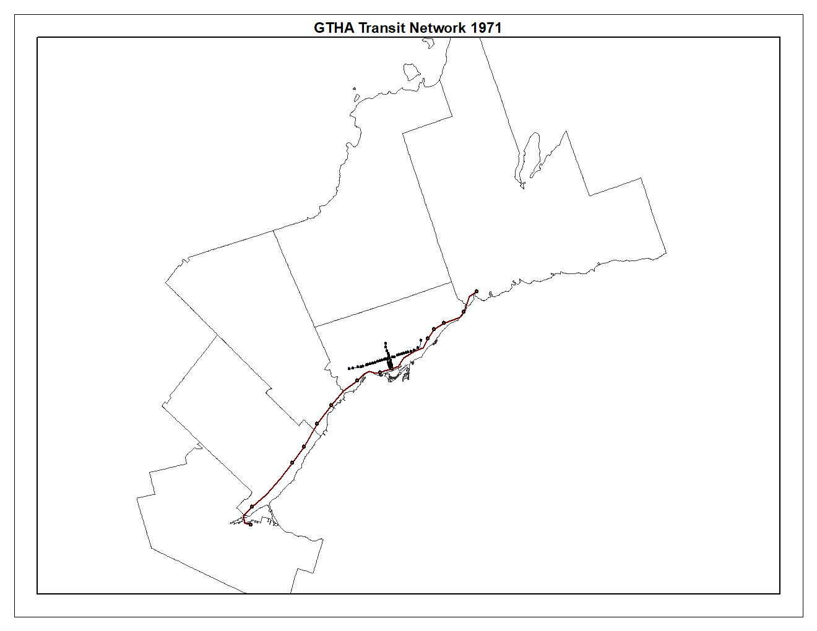
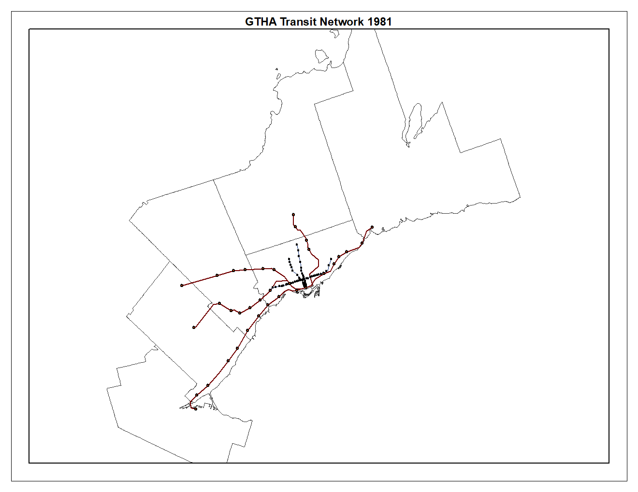
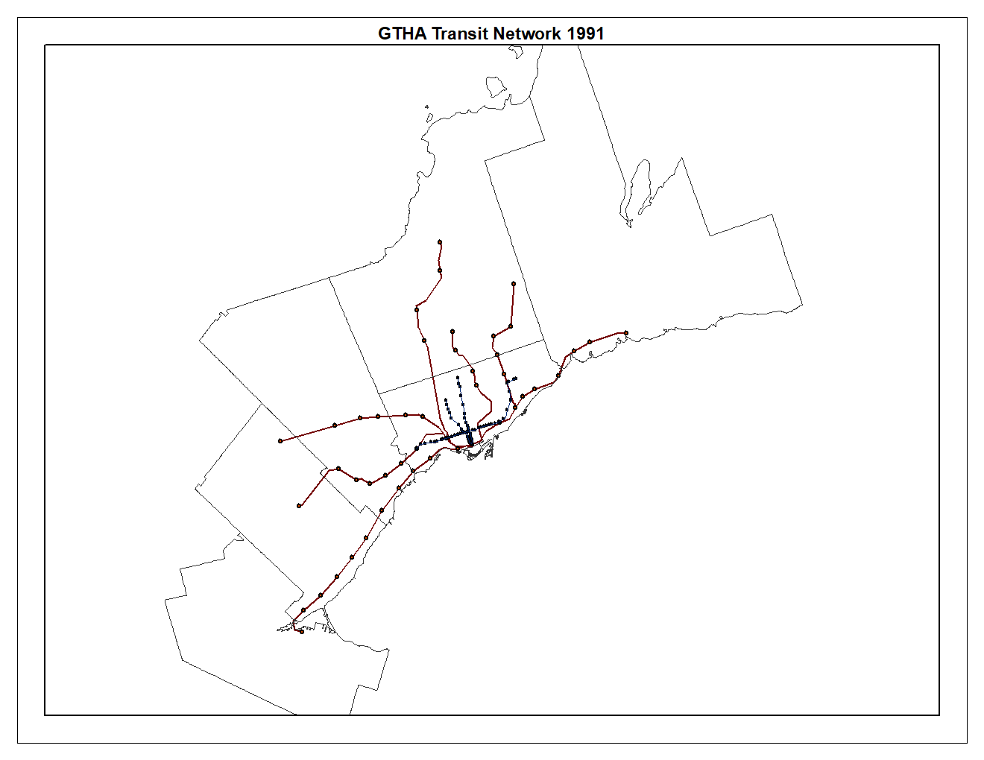
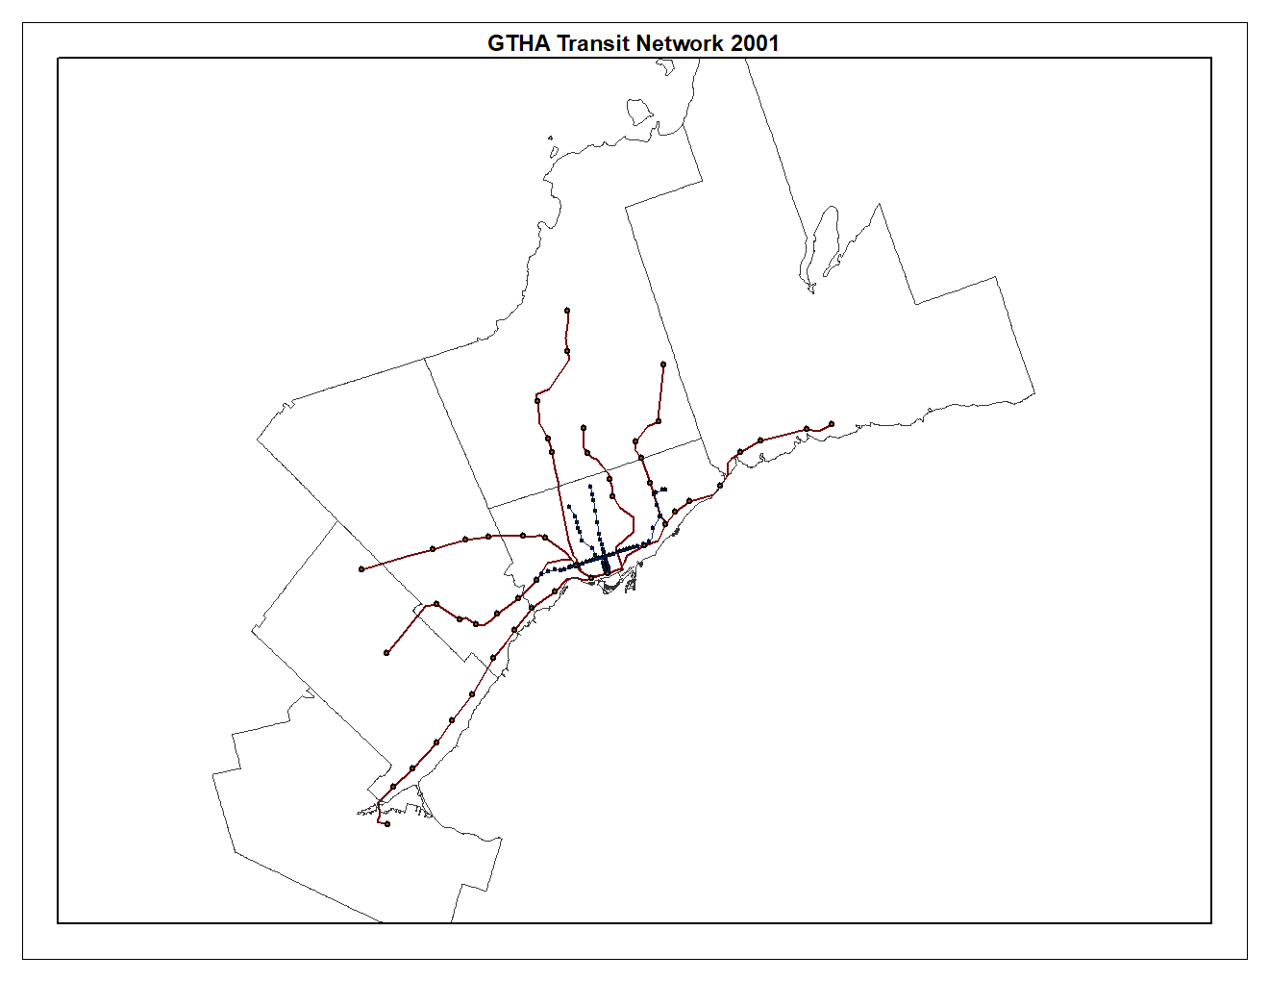
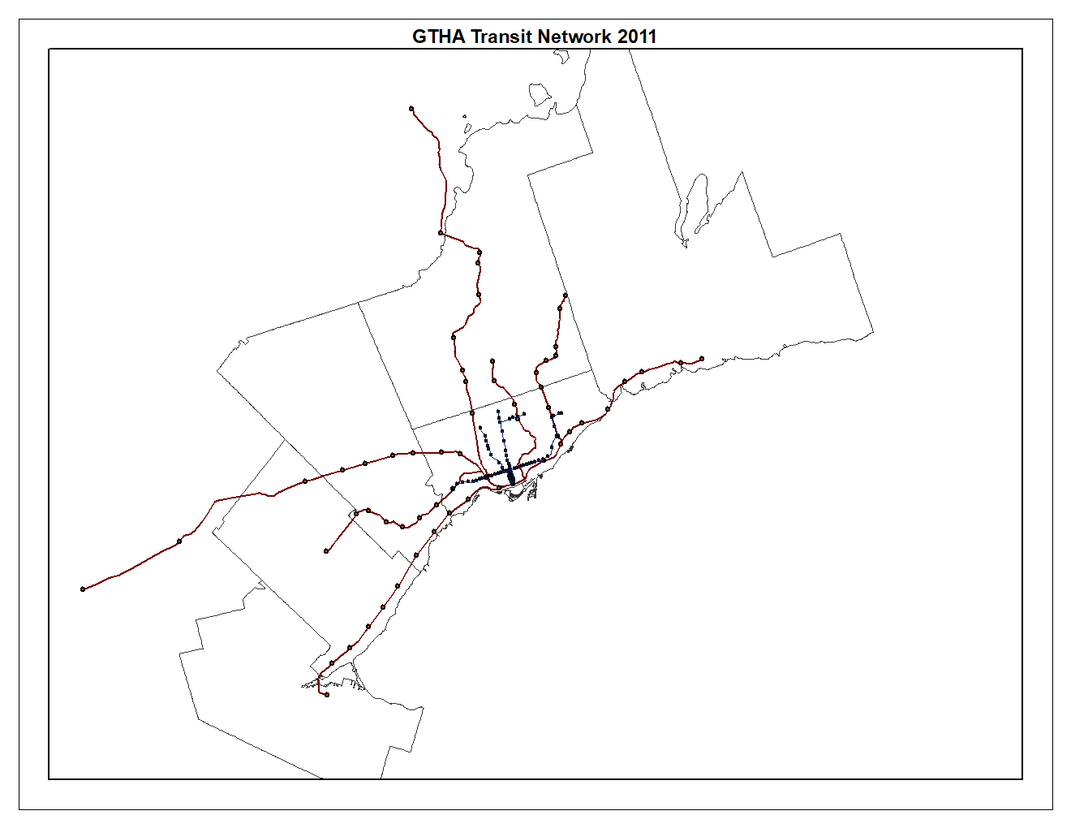
GTHA commuter rail and subway 1971 - 2011
1971
1981
1991
2001
2011

Slide 5
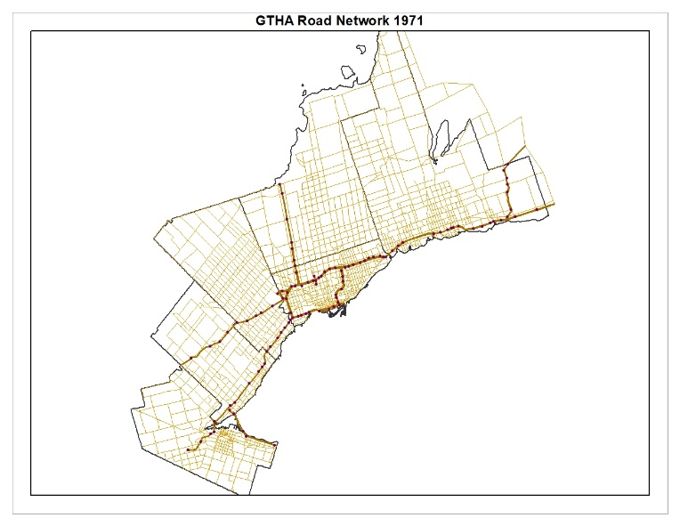


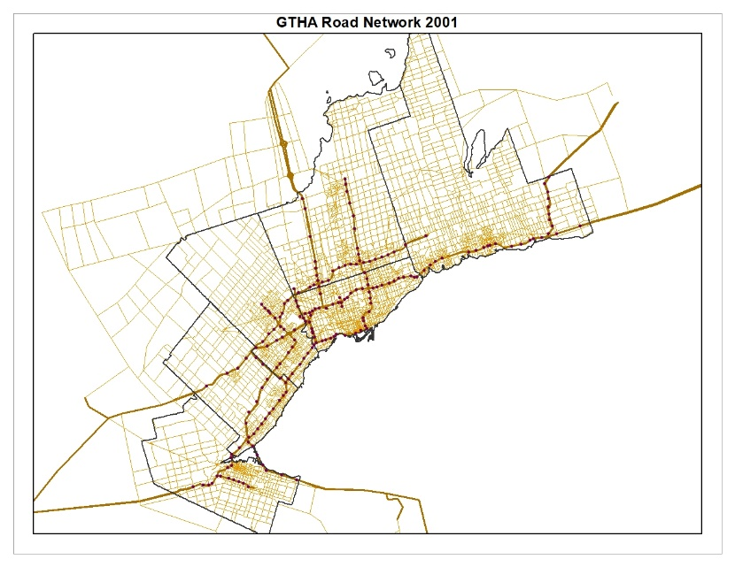

GTHA Road Network 1971 - 2011
1971
1981
1991
2001
2011

Slide 6
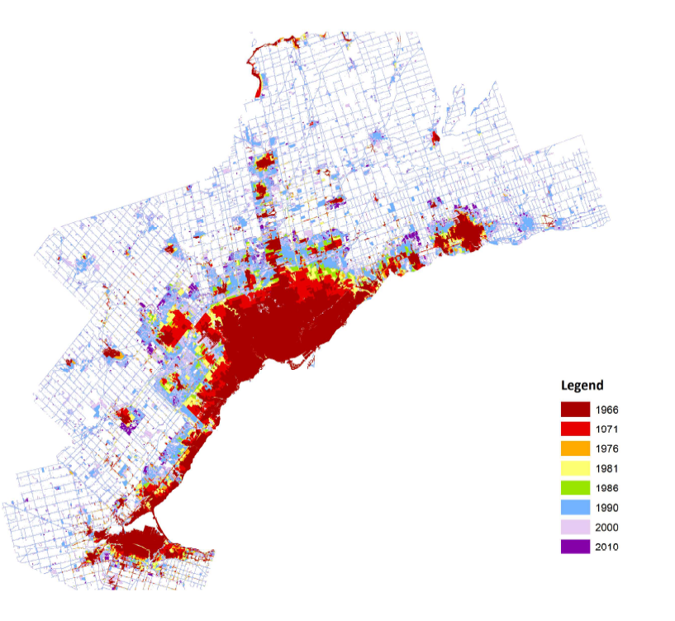
GTHA urbanisation

Slide 7
Accessibility in the GTHA
Travel time matrices:
by transit and road
at the TAZ level (approx. 2300)
for ten time points of five year intervals from 1971 to 2016, using EMME networks (networks before 1986 were constructed retrospectively)
→ approx. 5 million ODs per mode per time point

Slide 8
Accessibility in the GTHA
Travel time matrices:
Transit
GO train + subway + streetcar + bus (GO and normal)
Transit time = walk time (access/egress) + wait time (average headway) + in transit vehicle time
Road
Free flow travel times
Travel times with congestion

Slide 9
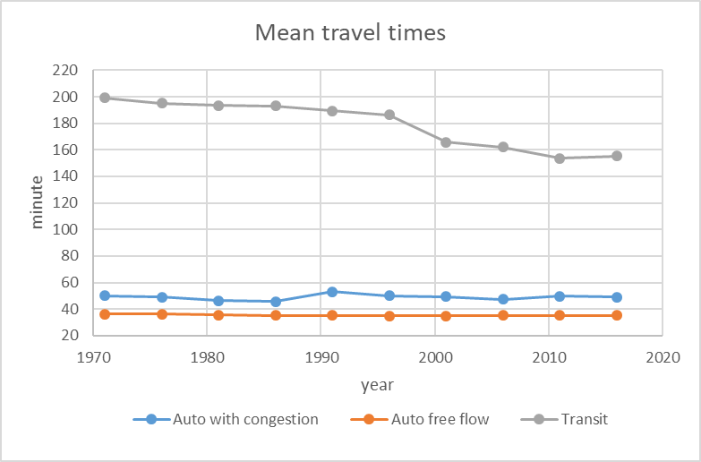
Travel time development (all ODs)

Slide 10
Observations
Transit travel times > auto travel times (with congestion) > auto travel times (free flow)
Transit travel times have decreased over time with the improvement of the transit network
The ultimate combination of changes in the road network and demand has resulted in relatively stable auto travel times at the network level over time

Slide 11
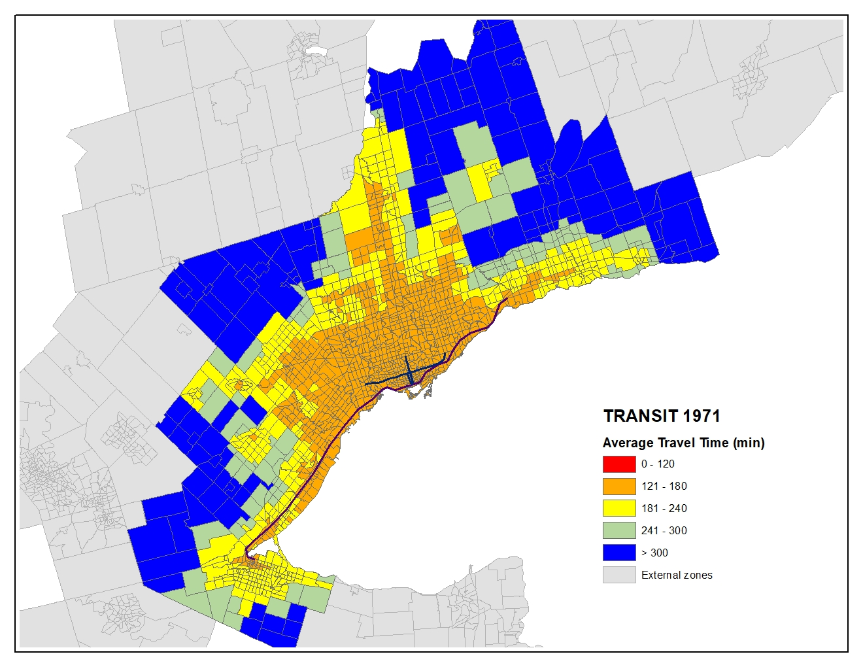
Average transit time - 1971

Slide 12
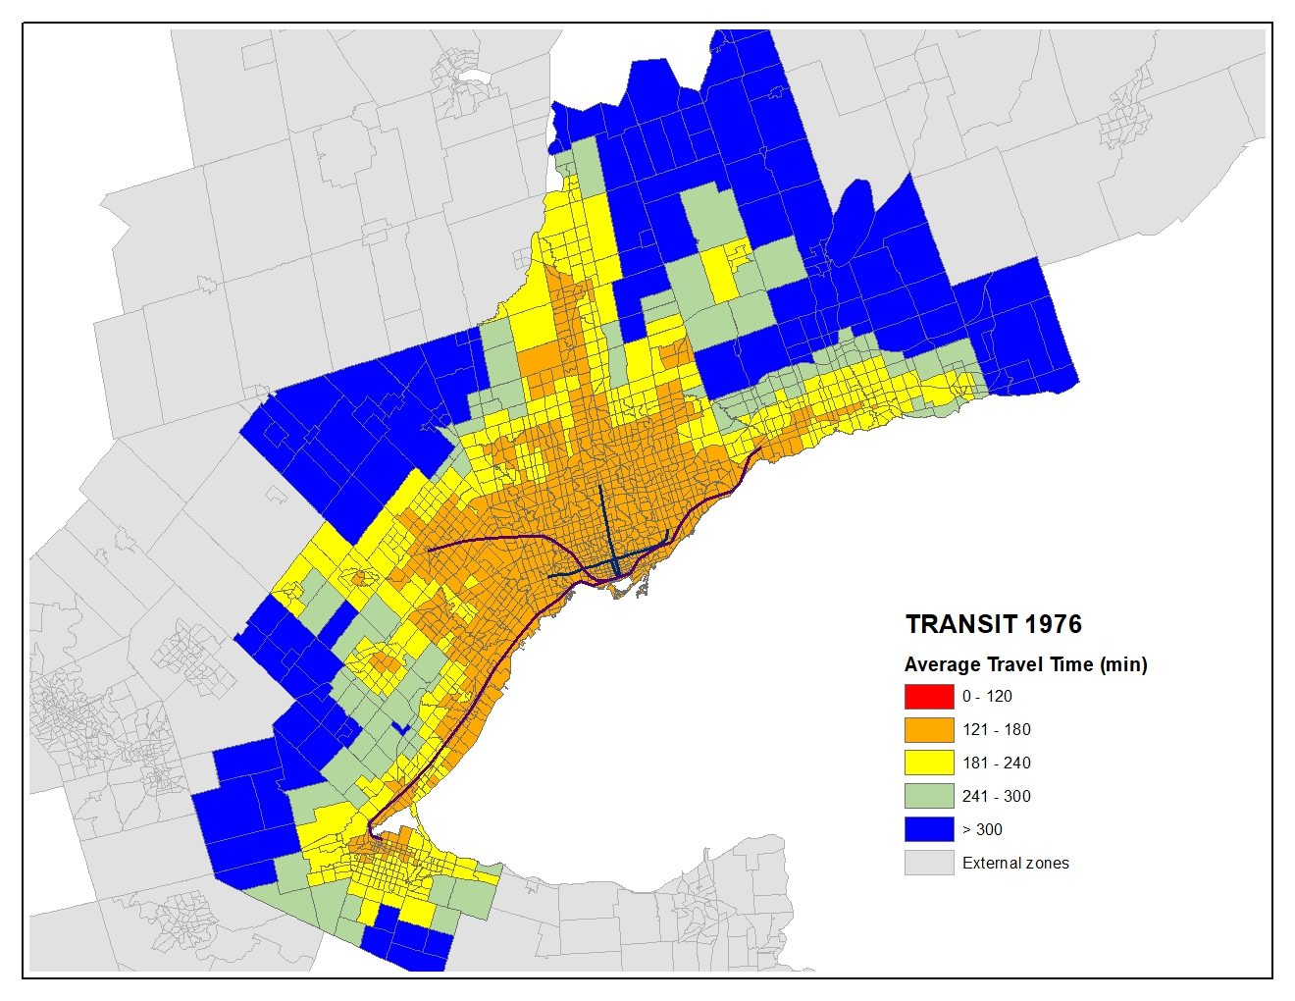
Average transit time - 1976

Slide 13
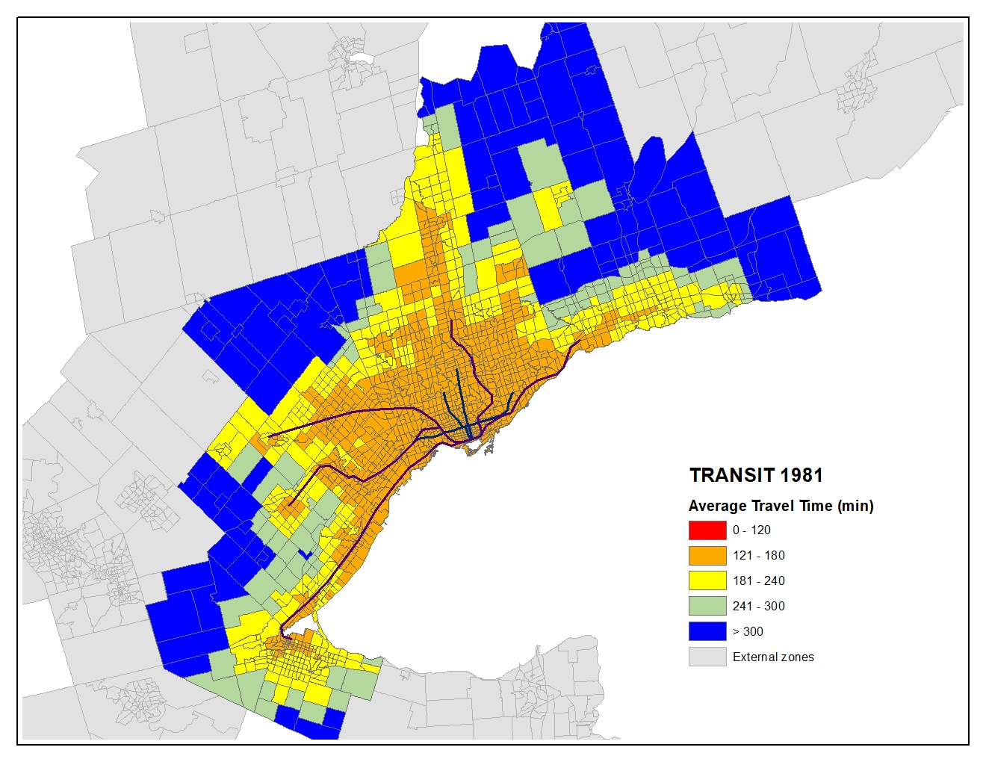
Average transit time - 1981

Slide 14

Average transit time - 1986

Slide 15
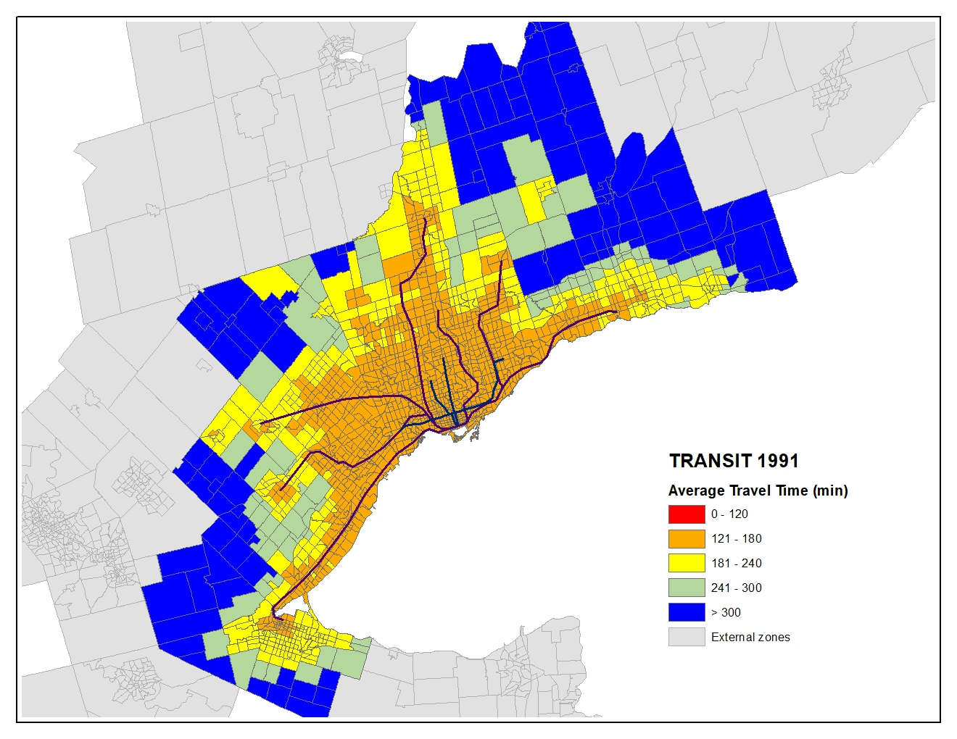
Average transit time - 1991

Slide 16
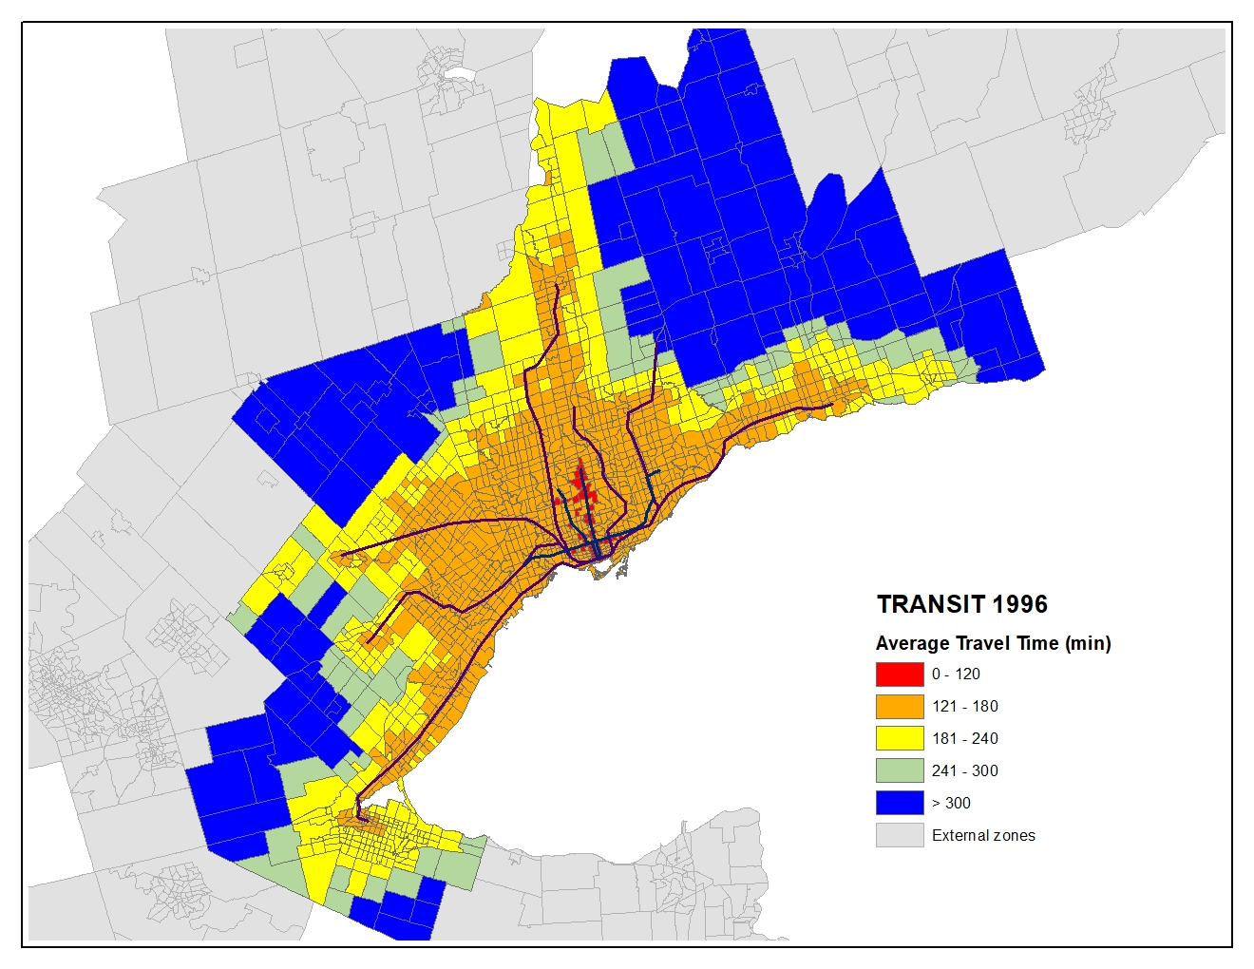
Average transit time - 1996

Slide 17
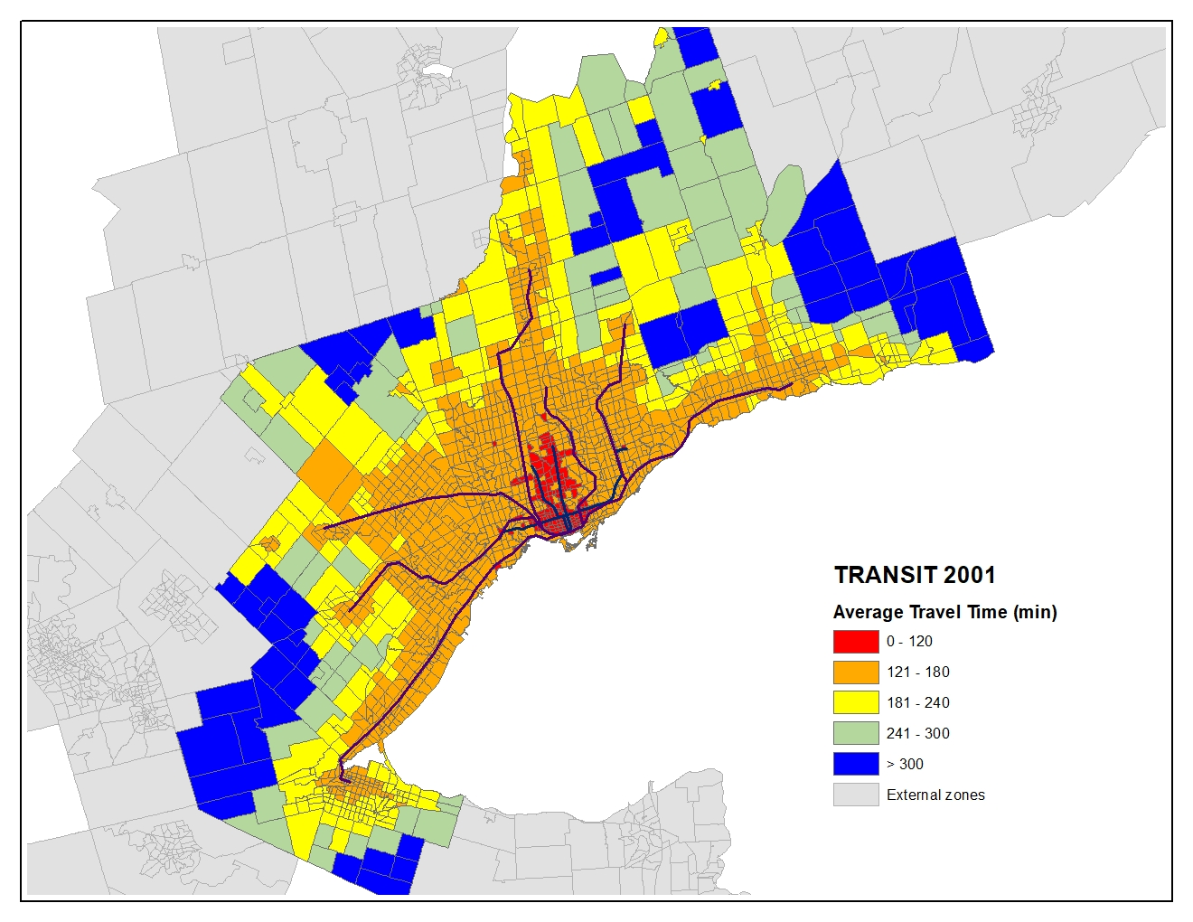
Average transit time - 2001

Slide 18
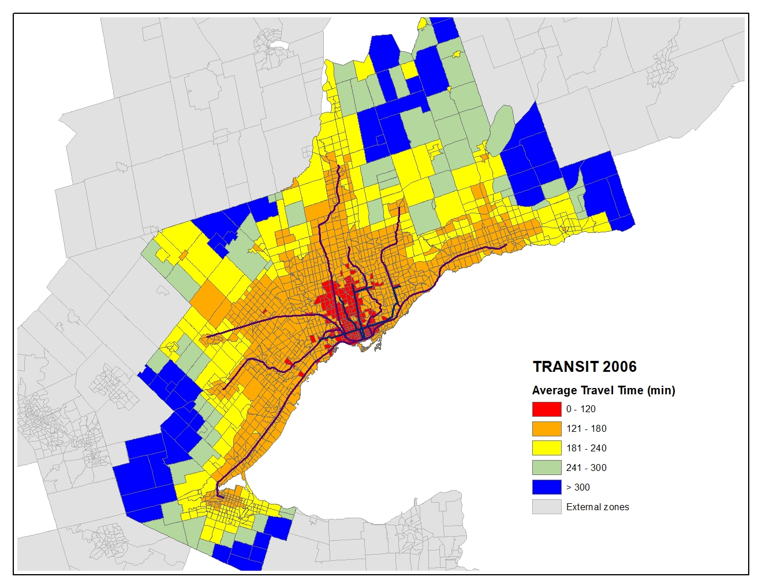
Average transit time - 2006

Slide 19
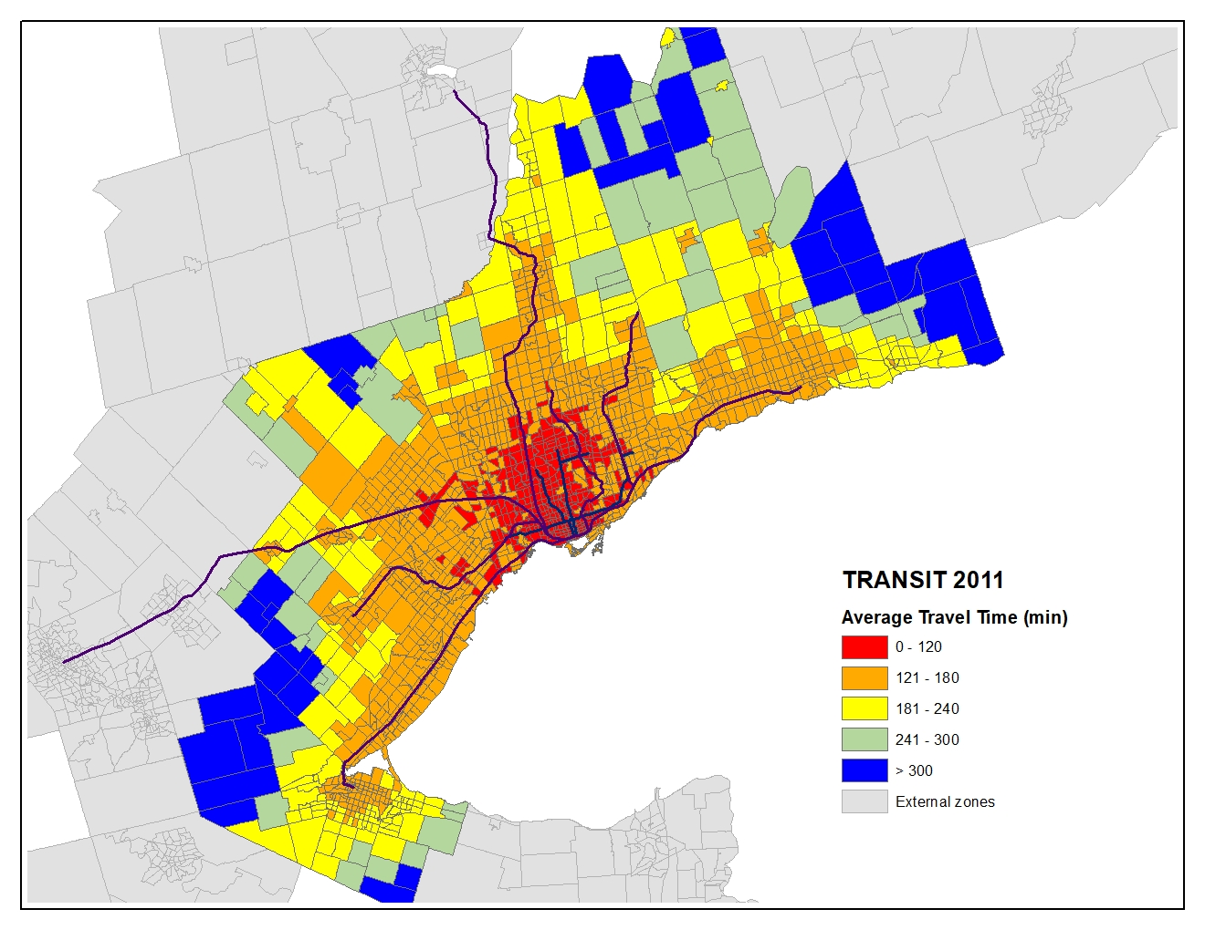
Average transit time - 2011

Slide 20

Average transit time - 2016

Slide 21
Next steps
Include drive access time
Add longitudinal census data→ urban densities
Gravity based network accessibility indicators by transit and road
longitudinal analyses to measure the role of transport accessibility in i) population change, ii) urbanisation, iii) land value, iv) equity,…
Investigate the reverse impact of urbanisation on transport networks

Slide 22
Thank you!
Questions?

